Slide 1
Overview of Banking
Fresher Learning Program

Slide 2
What is a Bank
A bank is a financial institution licensed to receive deposits and make loans. Banks may also provide financial services such as wealth management, currency exchange, and safe deposit boxes. There are several different kinds of banks including retail banks, commercial or corporate banks, and investment banks. In most countries, banks are regulated by the national government or central bank.
Banks are a very important part of the economy because they provide vital services for both consumers and business. As financial services providers, they give you a safe place to store your cash. Through a variety of account types such as checking and savings accounts, and certificates of deposit (CDs), you can conduct routine banking transactions like deposits, withdrawals, check writing, and bill payments. You can also save your money and earn interest on your investment.

Slide 3
Types of Banks
Retail Banking
Retail banks deal specifically with retail consumers, though some global financial services companies contain both retail and commercial banking divisions. These banks offer services to the general public and are also called personal or general banking institutions. Retail banks provide services such as checking and savings accounts, loan and mortgage services, financing for automobiles, and short-term loans like overdraft protection.
Many larger retail banks also offer credit card services to their customers, and may also supply their clients with foreign currency exchange. Larger retail banks also often cater to high-net-worth individuals, giving them specialty services such as private banking and wealth management.

Slide 4
Types of Banks
2. Corporate Banking
Commercial or corporate banks provide specialty services to their business clients from small business owners to large, corporate entities. Along with day-to-day business banking, these banks also provide their clients with other things such as credit services, cash management, commercial real estate services, employer services, and trade finance.
3. Investment Banks
Investment banks focus on providing corporate clients with complex services and financial transactions such as underwriting and assisting with merger and acquisition (M&A) activity. As such, they are known primarily as financial intermediaries in most of these transactions. Clients commonly range from large corporations, other financial institutions, pension funds, governments, and hedge funds. Morgan Stanley and Goldman Sachs are examples of U.S. investment banks.

Slide 5
Reserve Bank of India (RBI)
The Reserve Bank of India (RBI) is India's central bank and regulatory body under the jurisdiction of Ministry of Finance, Government of India. It is responsible for the issue and supply of the Indian rupee and the regulation of the Indian banking system. It also manages the country's main payment systems and works to promote its economic development.
The preamble of the Reserve Bank of India describes the basic functions of the reserve bank as:
"to regulate the issue of Bank notes and keeping of reserves with a view to securing monetary stability in India and generally to operate the currency and credit system of the country to its advantage; to have a modern monetary policy framework to meet the challenge of an increasingly complex economy, to maintain price stability while keeping in mind the objective of growth."

Slide 6
Reserve Bank of India (RBI)
Major functions of RBI are as follows:
Issue of Bank Notes
The Reserve Bank of India has the sole right to issue currency notes. Currency notes issued by the Reserve Bank are declared unlimited legal tender throughout the country. This concentration of notes issue function with the Reserve Bank has a number of advantages:
It brings uniformity in notes issue;
It makes possible effective state supervision;
It is easier to control and regulate credit in accordance with the requirements in the economy; and
It keeps faith of the public in the paper currency.

Slide 7
Reserve Bank of India (RBI)
2. Banker to Government
As banker to the government the Reserve Bank manages the banking needs of the government. It has to-maintain and operate the government’s deposit accounts. It collects receipts of funds and makes payments on behalf of the government. It represents the Government of India as the member of the IMF and the World Bank.
3. Custodian of Cash Reserves of Commercial Banks
The commercial banks hold deposits in the Reserve Bank and the latter has the custody of the cash reserves of the commercial banks.

Slide 8
Reserve Bank of India (RBI)
4. Custodian of Country’s Foreign Currency Reserves
The Reserve Bank has the custody of the country’s reserves of international currency, and this enables the Reserve Bank to deal with crisis connected with adverse balance of payments position.
5. Lender of Last Resort
The commercial banks approach the Reserve Bank in times of emergency to tide over financial difficulties, and the Reserve bank comes to their rescue though it might charge a higher rate of interest.
Central Clearance and Account Settlement
Controller of Credit

Slide 9
Reserve Bank of India (RBI)
6. Central Clearance and Account Settlement
Since commercial banks have their surplus cash reserves deposited in the Reserve Bank, it is easier to deal with each other and settle the claim of each on the other through book keeping entries in the books of the Reserve Bank. The clearing of accounts has now become an essential function of the Reserve Bank.
7. Controller of Credit
Since credit money forms the most important part of supply of money, and since the supply of money has important implications for economic stability, the importance of control of credit becomes obvious. Credit is controlled by the Reserve Bank in accordance with the economic priorities of the government.

Slide 10
Reserve / Central Bank in Other Countries
Country | Name of Central Bank
Qatar | Qatar Central Bank
Saudi Arabia | Saudi Arabian Monetary Agency
United Arab Emirates | UAE Central Bank
United Kingdom | Bank of England
United States of America | Federal Reserve System

Slide 11
Banking Scenario in India
Legal and Regulatory provisions
Key laws to control and regulate banking in India -
The Reserve Bank of India (RBI) Act, 1934 – Empowers RBI, the central bank of India, to control and regulate the banking business
Banking Regulations Act 1949 – Defines the business of banking, its rules and regulations
Negotiable Instruments Act 1881 – Rules to deal with negotiable instruments - cheques, bills of exchange and promissory notes
Bankers’ Books Evidence Act 1891 – for record keeping of banking trnx
Foreign Exchange Management Act 1999 – Foreign exchange to facilitate external trade and payments, investment avenues for NRIs and foreign direct investment in India
“Payment and Settlement System Act 2002 - Provides for regulation and supervision of payment systems in India"

Slide 12
Core Banking System
Core Banking solutions are vital to the day-to-day functioning of any bank. It is an integral part of the banking technology which aims to serve their clients and customer with the best services. In simple words, core banking solutions are account-management back-end and front-end processes.
Core is short for “Centralized Online Real-time Exchange.” As the name suggests, it is a centralized system or a network created by a bank and its branches. This allows the customers of the bank to access, manage and perform basic transactions from any branch of the bank they hold an account in. Thus, core banking software allows the banks to create a centralized data center.
Some of the basic core banking solutions include deposit accounts, loans, payments and more. With the help of core banking software, these services are made available to the bank’s customers through ATMs, internet banking, mobile banking, and brick and mortar bank branches. Core banking system uses Information Communication Technology as a platform for its various applications to simplify banking procedures and processes.

Slide 13
Key Factors of Core Banking System
Customer of the bank across all branches
Real time on-line 24 hours banking through branch, ATM, Internet, Mobile & Merchant Establishments
Centralized operations, moving out processing tasks from branches
Instant availability of account information to customer
Instant and accurate availability of MIS to management
Reduced need for system related skills at branches
Uniform delivery of service to customer experience across the bank
Enhanced services and products to customers
More time to management and branch staff for sales and customer service
Improved monitoring of credit – reduced NPA
Improved control on transactions – better housekeeping

Slide 14

Core Banking Software Companies

Slide 15
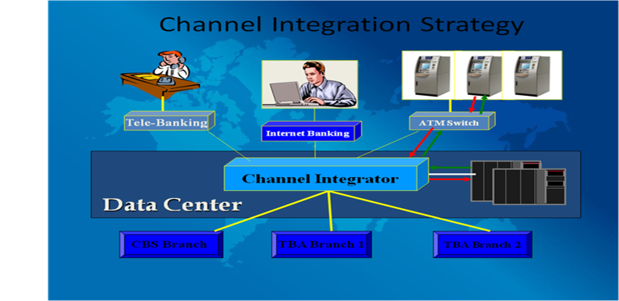

Slide 16
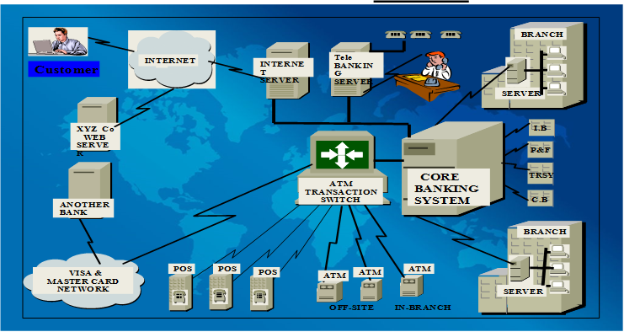

Slide 17
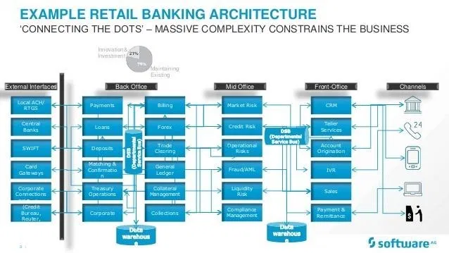

Slide 18


Slide 19
Automated Teller Machine
An automated teller machine (ATM) is an electronic banking outlet that allows customers to complete basic transactions without the aid of a branch representative or teller. Anyone with a credit card or debit card can access cash at most ATMs.
ATMs are convenient, allowing consumers to perform quick self-service transactions such as deposits, cash withdrawals, bill payments, and transfers between accounts. Fees are commonly charged for cash withdrawals by the bank where the account is located, by the operator of the ATM, or by both. Some or all of these fees can be avoided by using an ATM operated directly by the bank that holds the account.

Slide 20
Features of Automated Teller Machine (ATM)
Cash Withdrawal
Cash Deposit to Account
Cheque Deposit
Balance Enquiry
Mini Statement
Credit Card Payment
Utility Payments
Cheque Book request
Pin Change

Slide 21
Phone Banking
Telephone banking is a service provided by a bank or other financial institution, that enables customers to perform over the telephone a range of financial transactions which do not involve cash or Financial instruments (such as cheques), without the need to visit a bank branch or ATM.
Interactive Voice Response (IVR) is an automated phone system technology that allows incoming callers to access information via a voice response system of pre recorded messages without having to speak to an agent, as well as to utilize menu options via touch tone keypad selection or speech recognition to have their call routed to specific departments or specialists.

Slide 22
Features of Phone Banking
Account Related Information
Account Balance
Account Transactions
Credit Card Transactions
Cheque Book Request
Stop Payment of Cheque
Credit Card balance enquiry
Blocking of Debit/ Credit Card
Transfer of Funds

Slide 23
Online Banking
Online banking, also known as internet banking, web banking or home banking, is an electronic payment system that enables customers of a bank or other financial institution to conduct a range of financial transactions through the financial institution's website.
The online banking system will typically connect to or be part of the core banking system operated by a bank to provide customers access to banking services in place of traditional branch banking. Online banking significantly reduces the banks' operating cost by reducing reliance on a branch network, and offers greater convenience to customers in time saving in coming to a branch and the convenience of being able to perform banking transactions even when branches are closed.
Internet banking provides personal and corporate banking services offering features such as viewing account balances, obtaining statements, checking recent transactions, transferring money between accounts, and making payments.

Slide 24
Features of Online Banking
Viewing account balances
Viewing recent transactions
Downloading bank statements, for example in PDF format
Ordering cheque books
Set up Standing Instructions
Bill Payments ( Telephone, Utility Payments etc.).
CASA Sweep In
Open Fixed Deposits, Recurring Deposits
View Fixed , Recurring Deposits balance

Slide 25
Features of Online Banking
Liquidate Fixed Deposits
Add / Delete Beneficiary
Funds transfers between the customer's linked accounts
Domestic Payments ( RTGS, NEFT, IMPS)
International Payments
Investment purchase or sale
Loan Accounts balances
Credit card Balance, Statement
Credit Card Payment
Transaction Limit Set up

Slide 26
Debit Card
Debit Card Number
The 16-digit number (often grouped into four’s) found on the front of your debit card is known as the Card number. This number is also known as your Card Identification number and it is also stored in your card’s magnetic chip/strip so that whenever you use your card at a POS or an ATM terminal, the card number is read by the machine.
Card Verification Value
CVV is the abbreviated form for Card Verification Value. CVV is a three-digit number that is always located on the rear of your card. It is often written in bold italics and is mostly required to complete online transactions like shopping, paying bills and subscriptions, etc. CVV is a security and fraud-prevention measure put in place to further ensure that you are truly the owner of the card you use in transacting online. Generally, CVV numbers are requested for when you aren’t using the physical debit card.

Slide 27
Debit Card
Expiry Date of Debit Card
Expiration or Expiry Date is another important component of a debit card. Generally, expiration date is often written on a card as two-digits (representing the month) followed by another two-digit (representing the year) separated by a hyphen (-) of a forward slash (/).
Expiration date refers to the date which a card will no longer be valid to be used for transactions. Beyond this date, a debit card will cease to be valid for any type of transactions you want to use it to perform. Before a debit card expires though, the issuing institution would have alerted the holder and prepared a new card. The new card will come with new details: new 16-digits debit card number, new CVV, and of course, new expiration date.

